Slide 1
Spring Boot Application Setup and Configuration

Slide 2
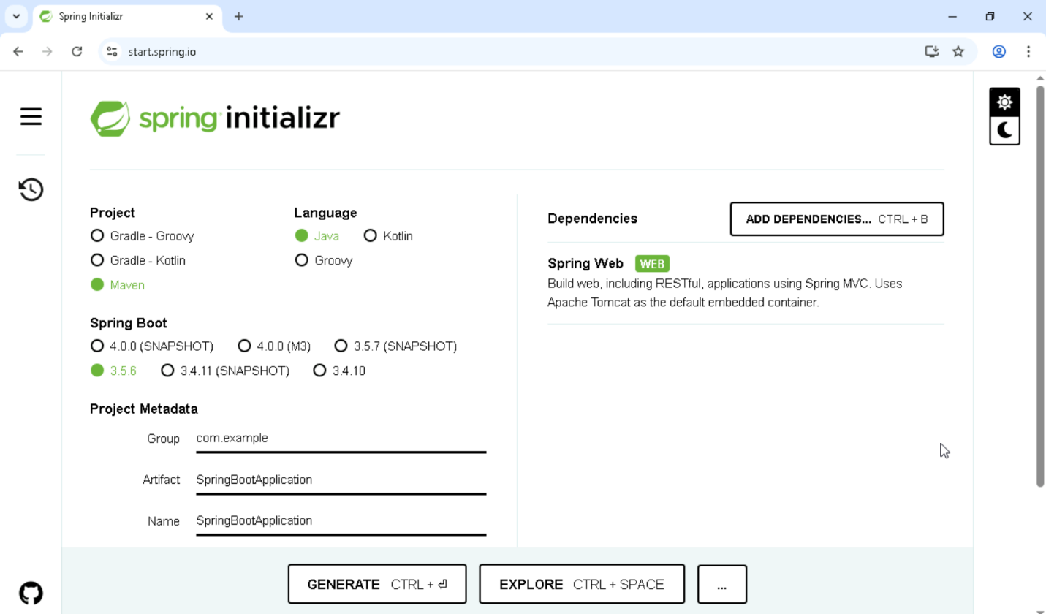
Create Project Using Spring Initializr
Go to https://start.spring.io
Choose:
Project: Maven
Language: Java
Spring Boot version (e.g., 3.x.x)
Group and Artifact names
Dependencies (e.g., Spring Web)
Click Generate to download the .zip file

Slide 3
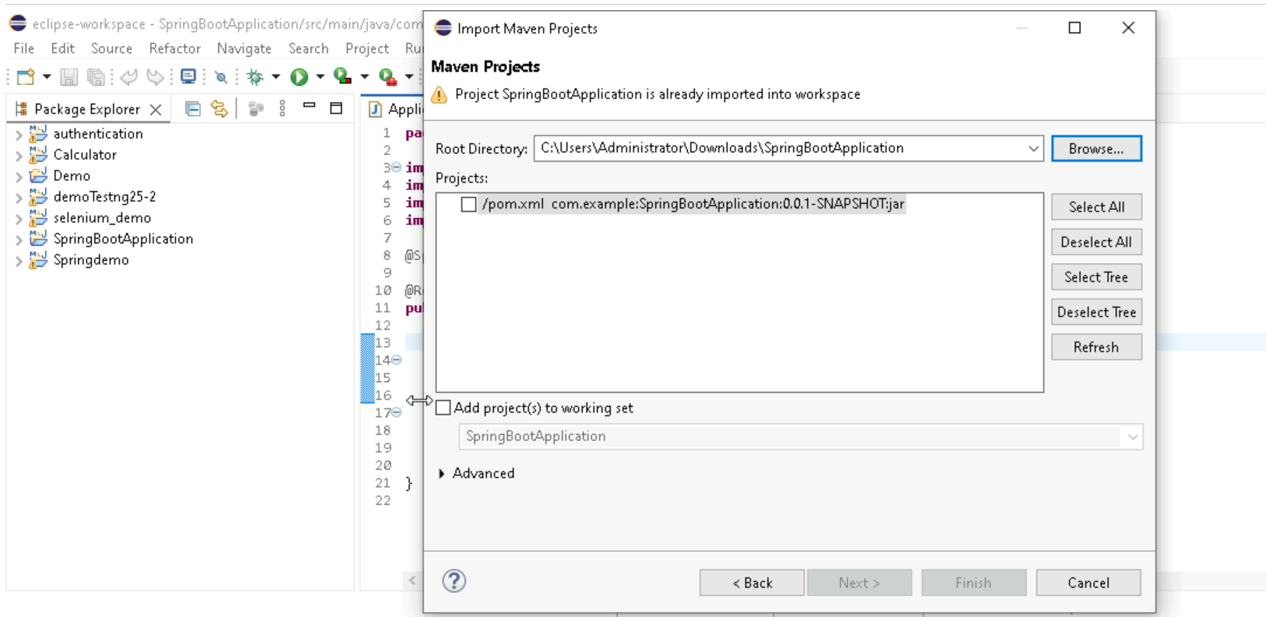
2. Extract and Open in Eclipse
Extract the downloaded .zip file
Open Eclipse IDE
Go to File → Import → Existing Maven Projects
Select the extracted folder and finish the import

Slide 4
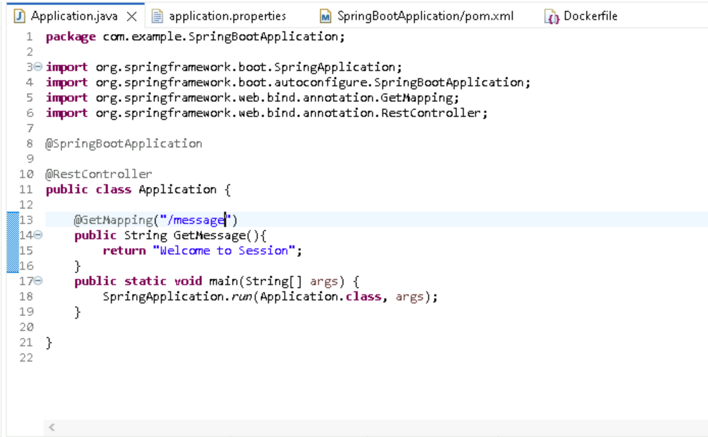
3. Modify Java Files to Add Endpoints
Navigate to src/main/java/com/example/demo
Open the main application class or create a new controller class
Add REST endpoints using @RestController and @RequestMapping or @GetMapping, etc.

Slide 5
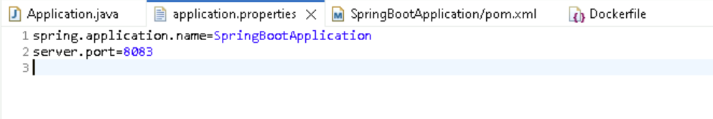
4. Change Server Port in application.properties
Go to src/main/resources/application.properties
Add or modify the following line to change the default port:
server.port=8081

Slide 6
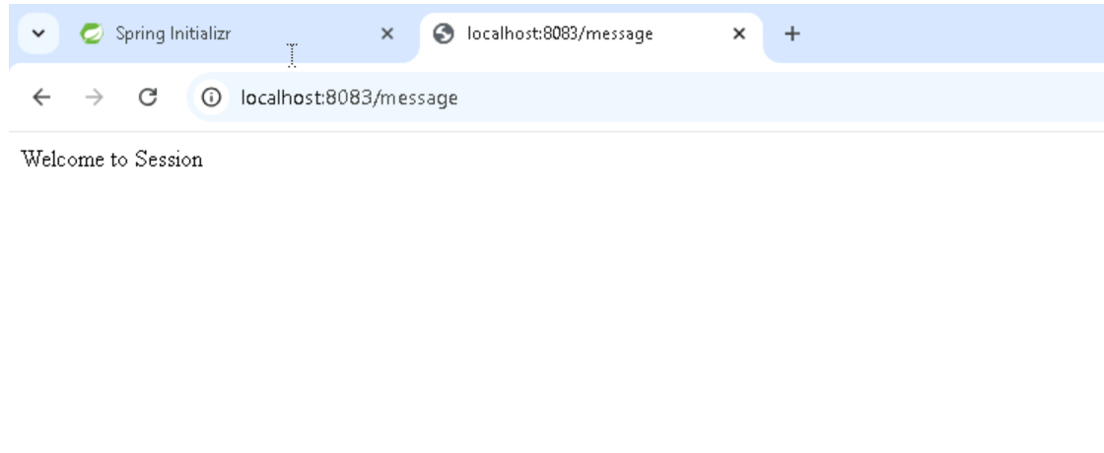
5. Update pom.xml as Needed
Open pom.xml file
Add or modify dependencies, plugins, or properties as required
6. Run and Test the Application
Right-click the main class → Run As → Java Application
Open browser and test endpoint: http://localhost:8083/message

Slide 7
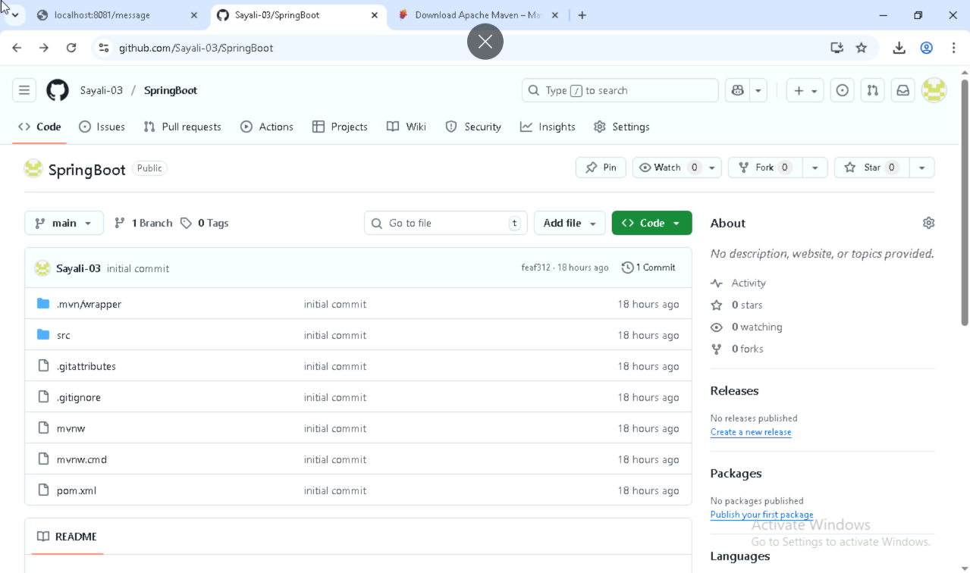
8. Push Spring Boot Project to GitHub
Initialize the git in project.
Create one repository in github.
Add the files, commit the changes and push the project to github repository.

Slide 8
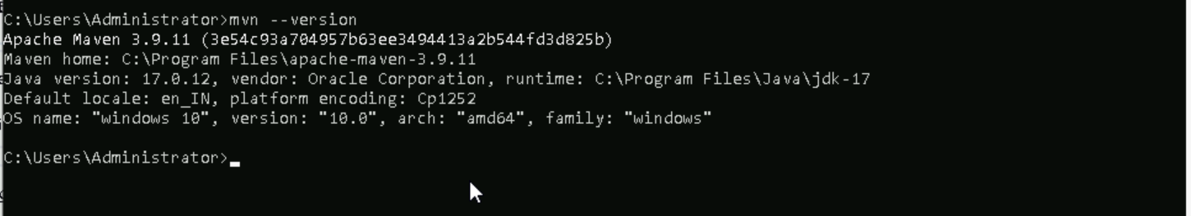
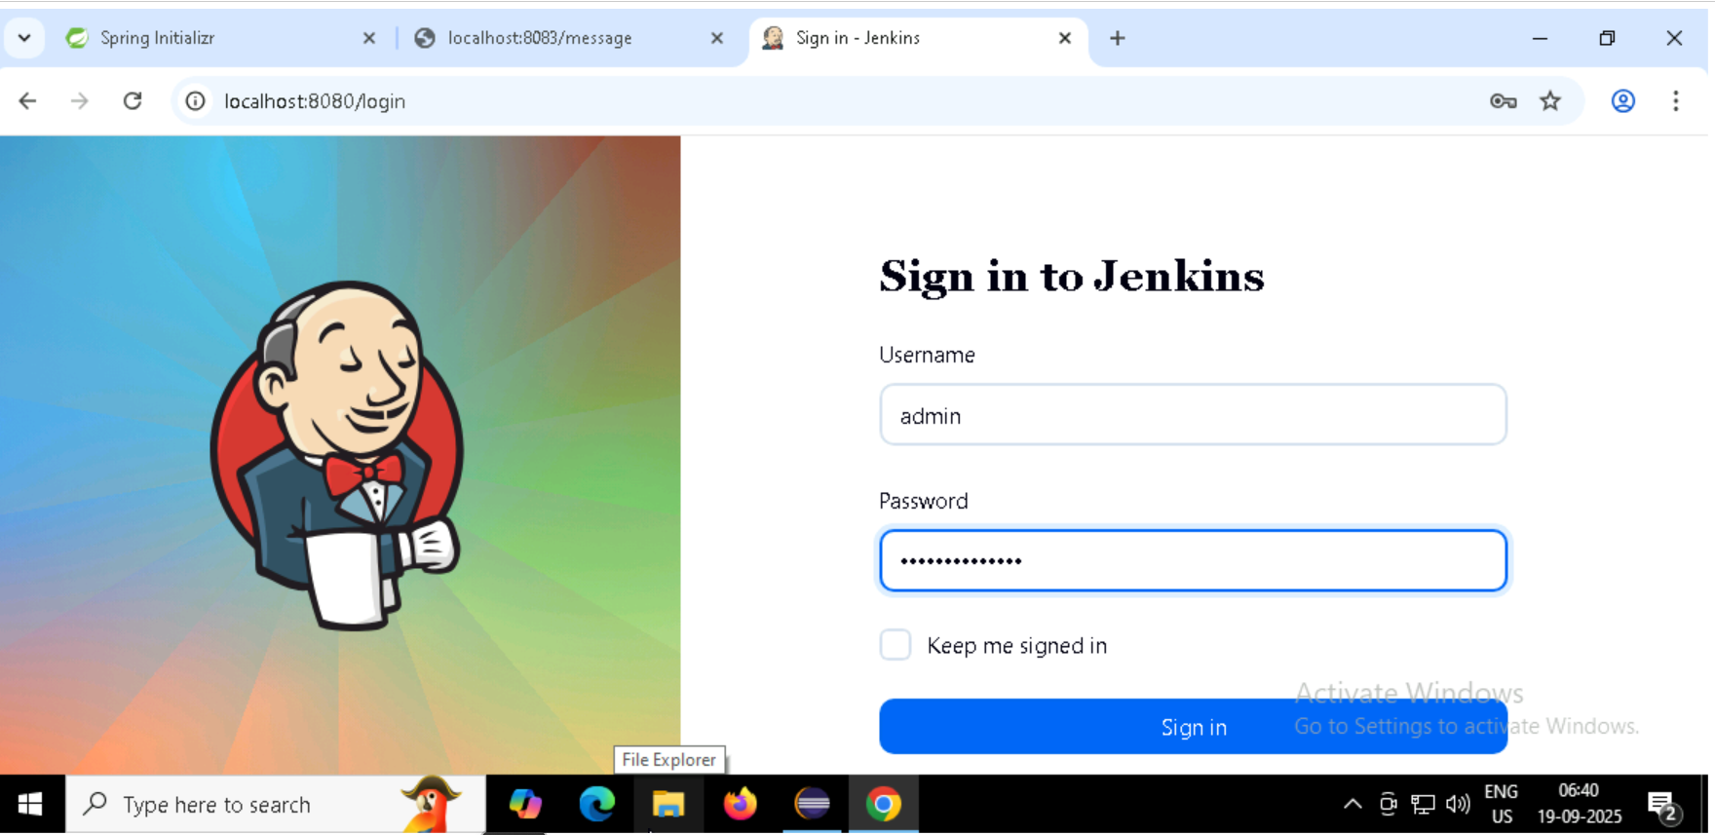
Jenkins Integration for Spring Boot Project
First Install the Maven in your system and update the environment variables –
Steps to Configure Jenkins
Login to Jenkins
Open Jenkins in your browser and log in using your credentials.

Slide 9
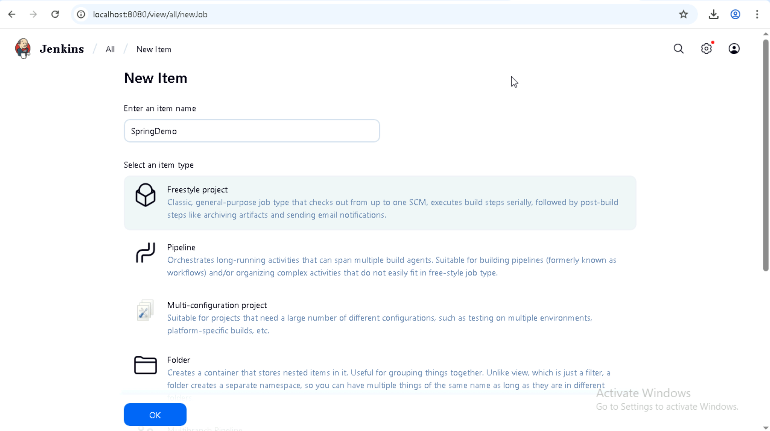
2. Create a New Project
Click on “New Item”.
Enter a project name and select “Freestyle project”.
Click OK to proceed

Slide 10
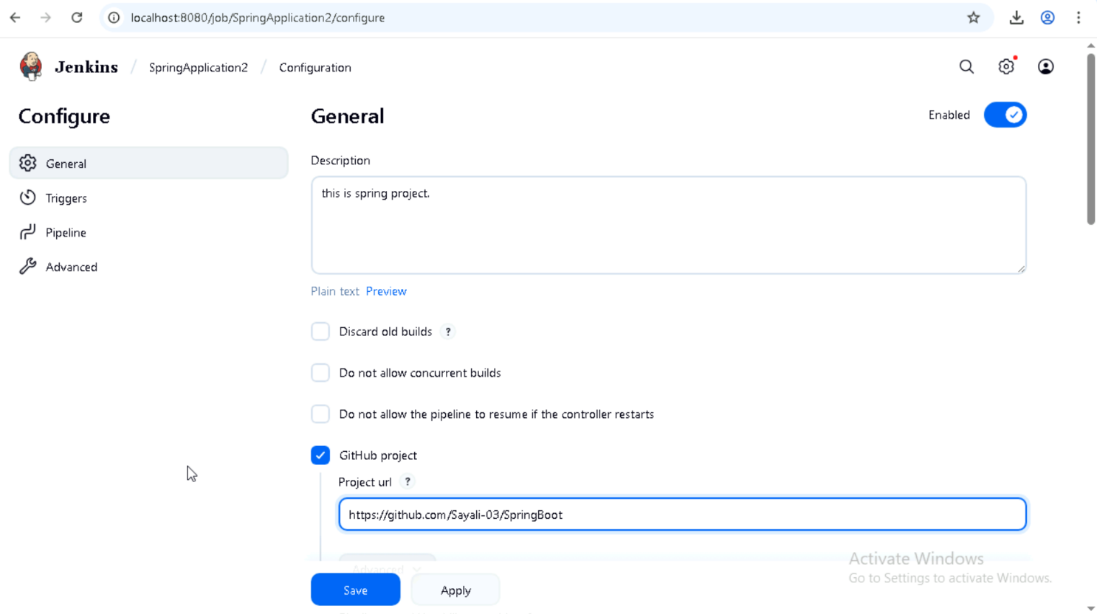
3. Configure Project Details
Add a project description.
Under Source Code Management, choose Git.
Enter your GitHub repository URL (Spring Boot project).
Add GitHub credentials (username and personal access token).

Slide 11
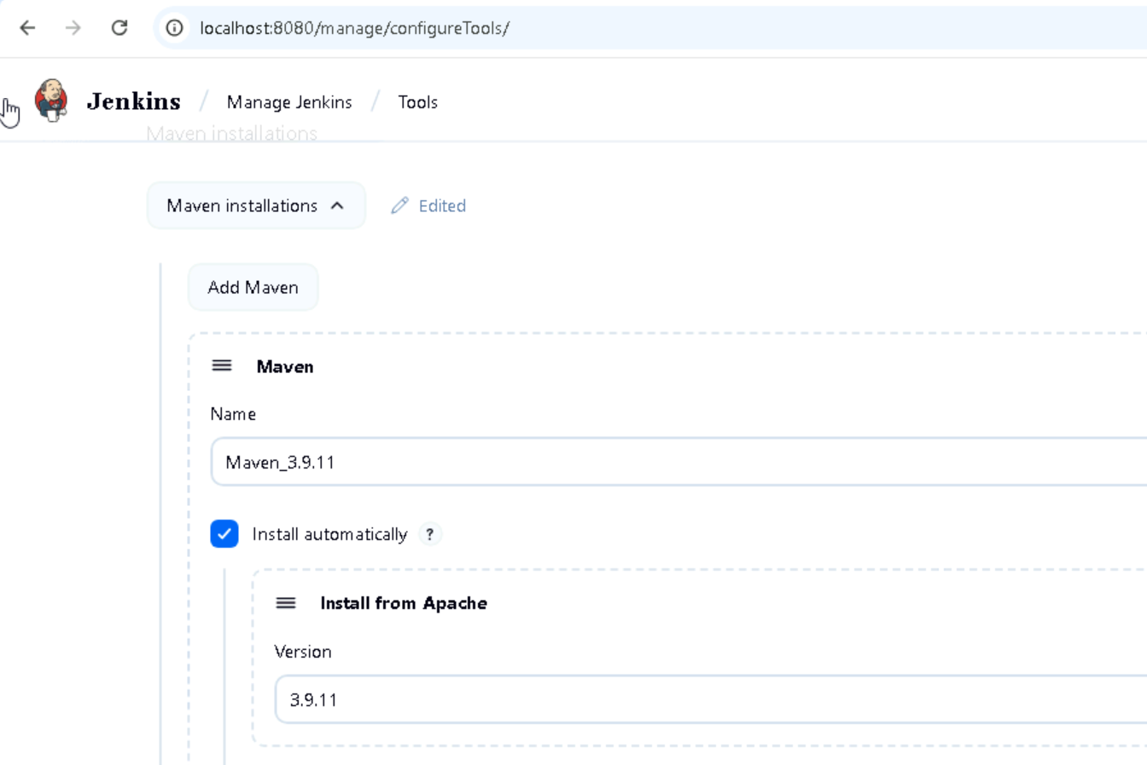
4. Configure Build Tools
Go to Build Environment → Tool Configuration.
Add and configure Maven (select installed Maven version).

Slide 12
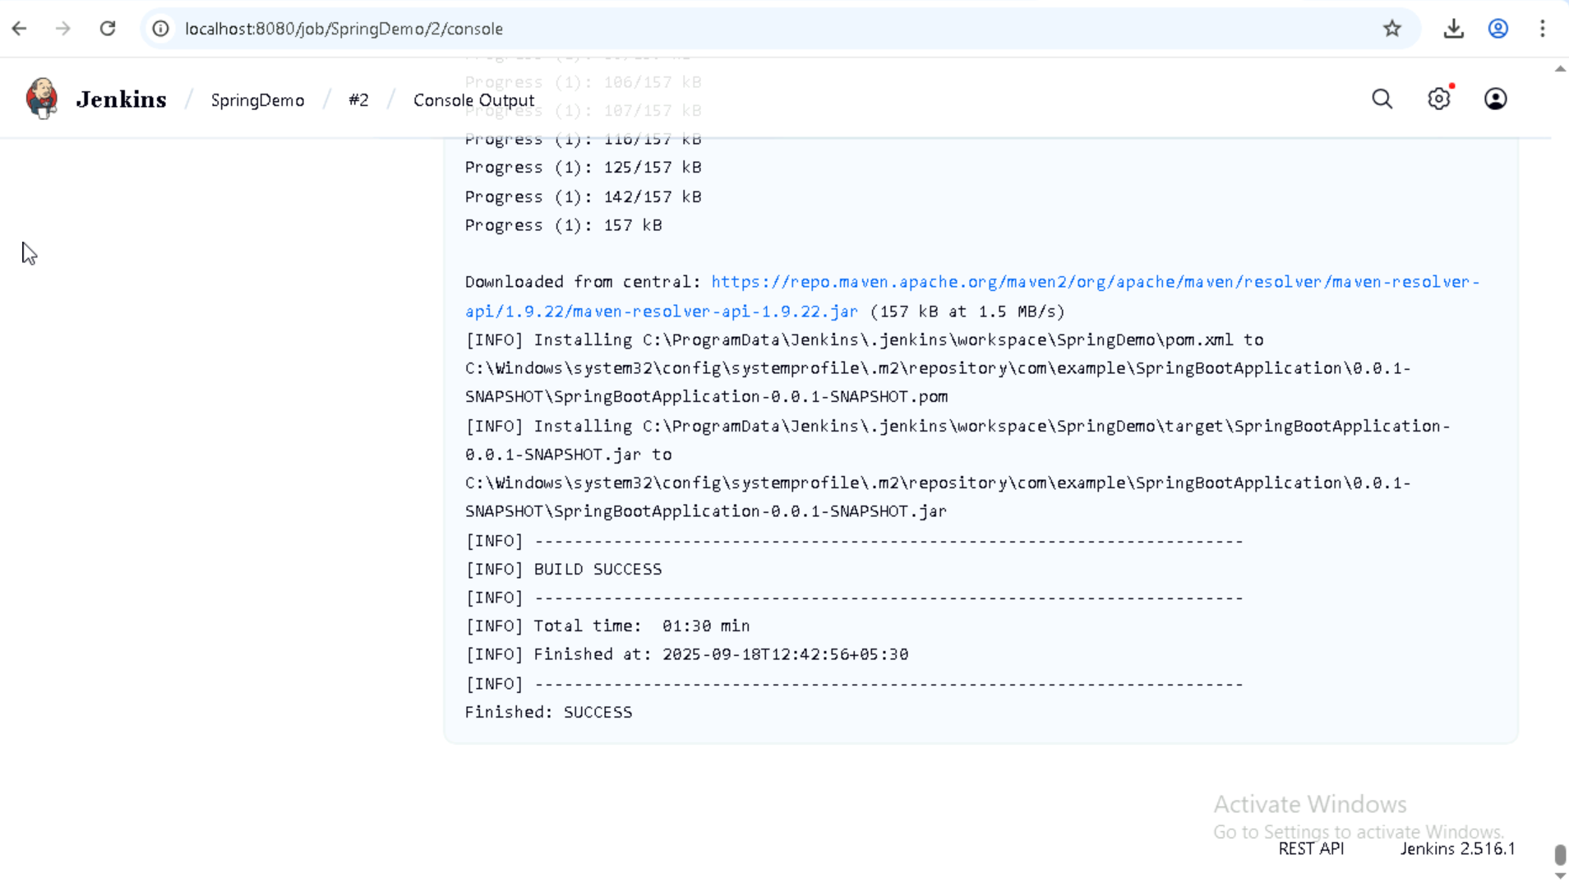
5. Build the Project
In the Build section, add a Maven command like clean install.
Save the configuration and click Build Now.
Check the Console Output to confirm build success.

Slide 13
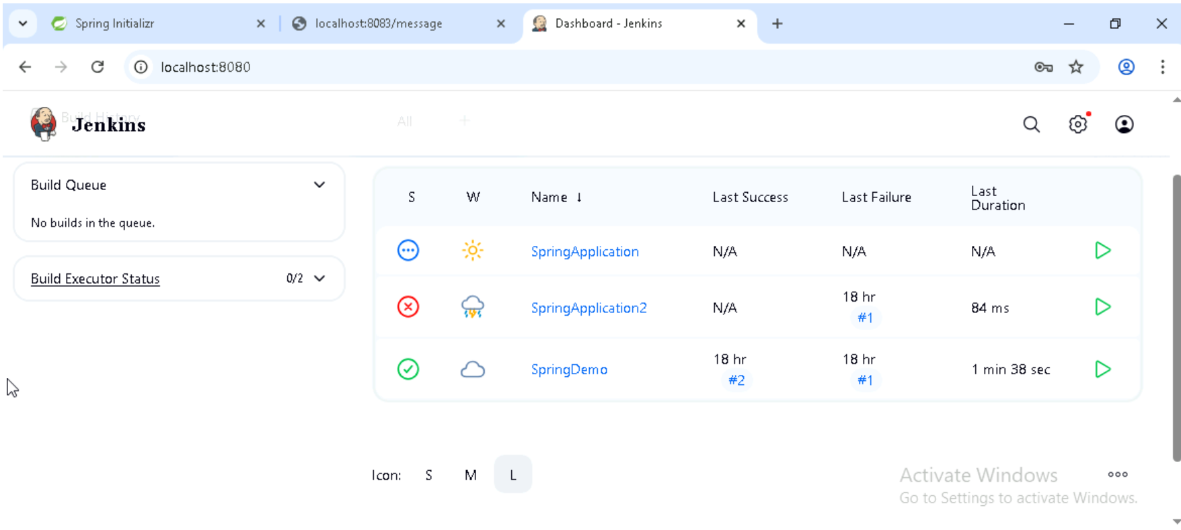
6. Verify Build Success
A successful build will show a green checkmark.
Artifacts (like JAR files) will be generated and stored.

Slide 14
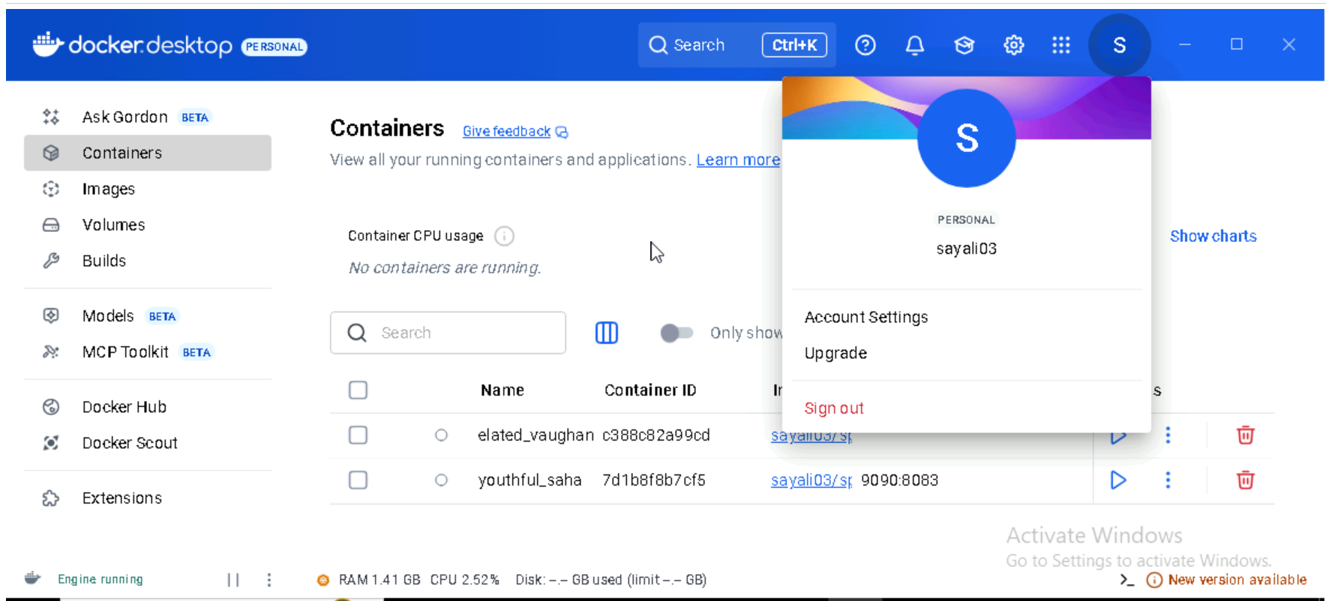
Docker Integration with Spring Boot -
Step 1: Create a DockerHub Account and Login via Docker Desktop
Go to https://hub.docker.com and create an account.
DockerHub is a cloud-based registry where you can store and share container images.
Open Docker Desktop and log in using your DockerHub credentials.

Slide 15
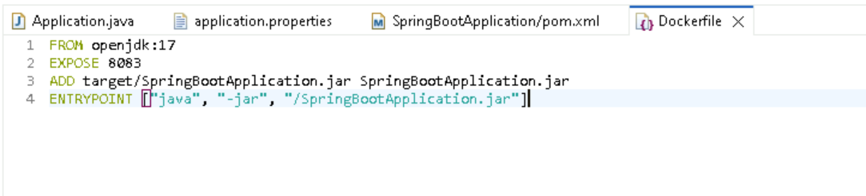
Step 2: Create a Dockerfile in Your Spring Boot Project
Place the Dockerfile in the root directory of your Spring Boot project.
This file defines how your Spring Boot app will be packaged into a Docker image.

Slide 16
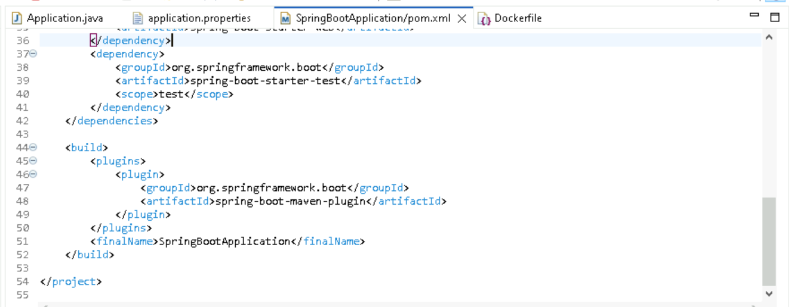
Step 3: Update pom.xml to Package the Application
Update the finalName in pom.xml file. Ensures your project can be compiled into a runnable JAR for Docker.

Slide 17
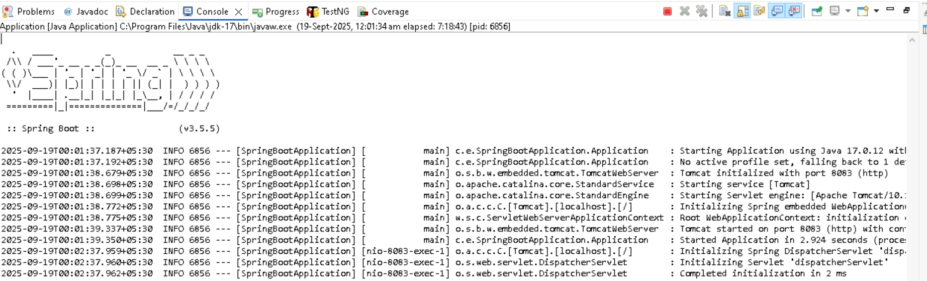
Step 4: Run Maven Install to Build the Project
Compiles the code and packages it into a JAR file inside the target/ folder.
Run as maven 6 install.

Slide 18
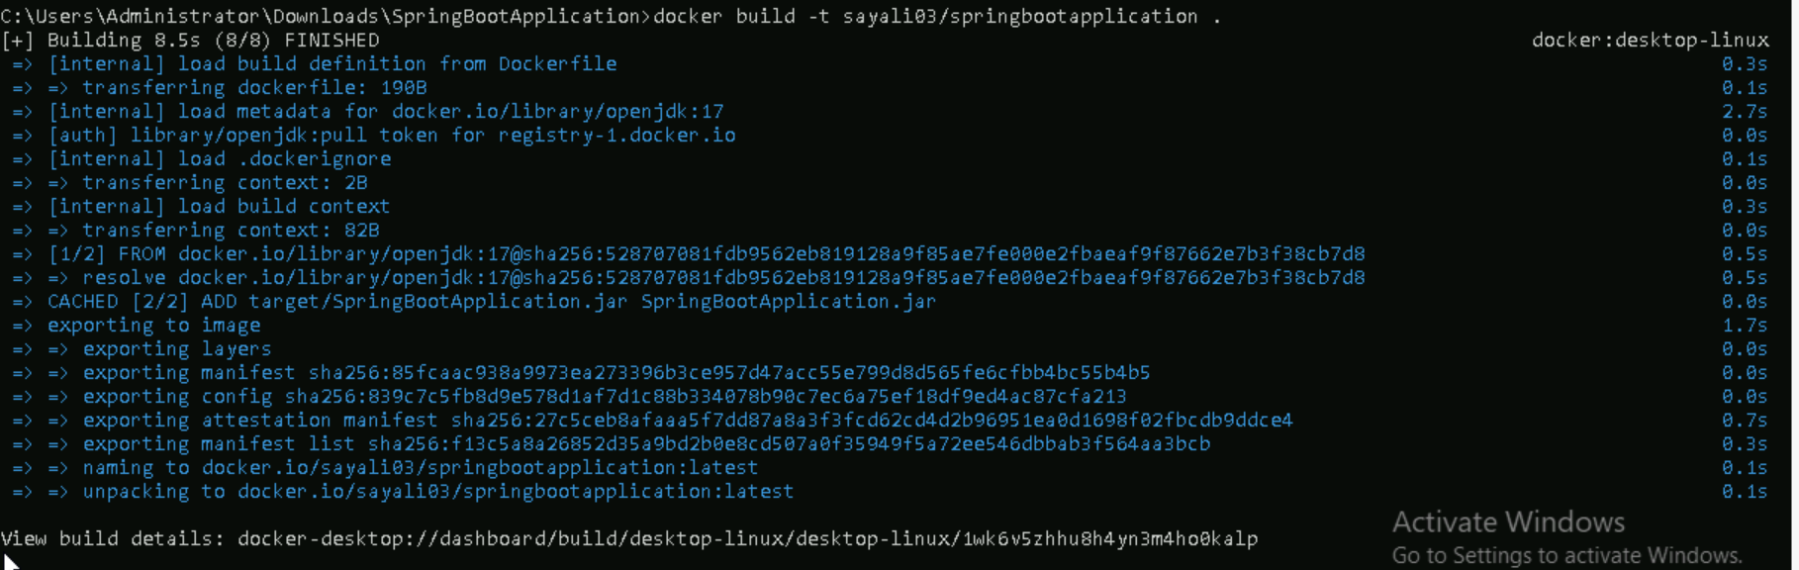
Step 5: Build the Docker Image
Command: docker build -t sayali03/springbootapplication .
Creates a Docker image from your project using the Dockerfile. The -t flag tags the image with your DockerHub username and image name.

Slide 19
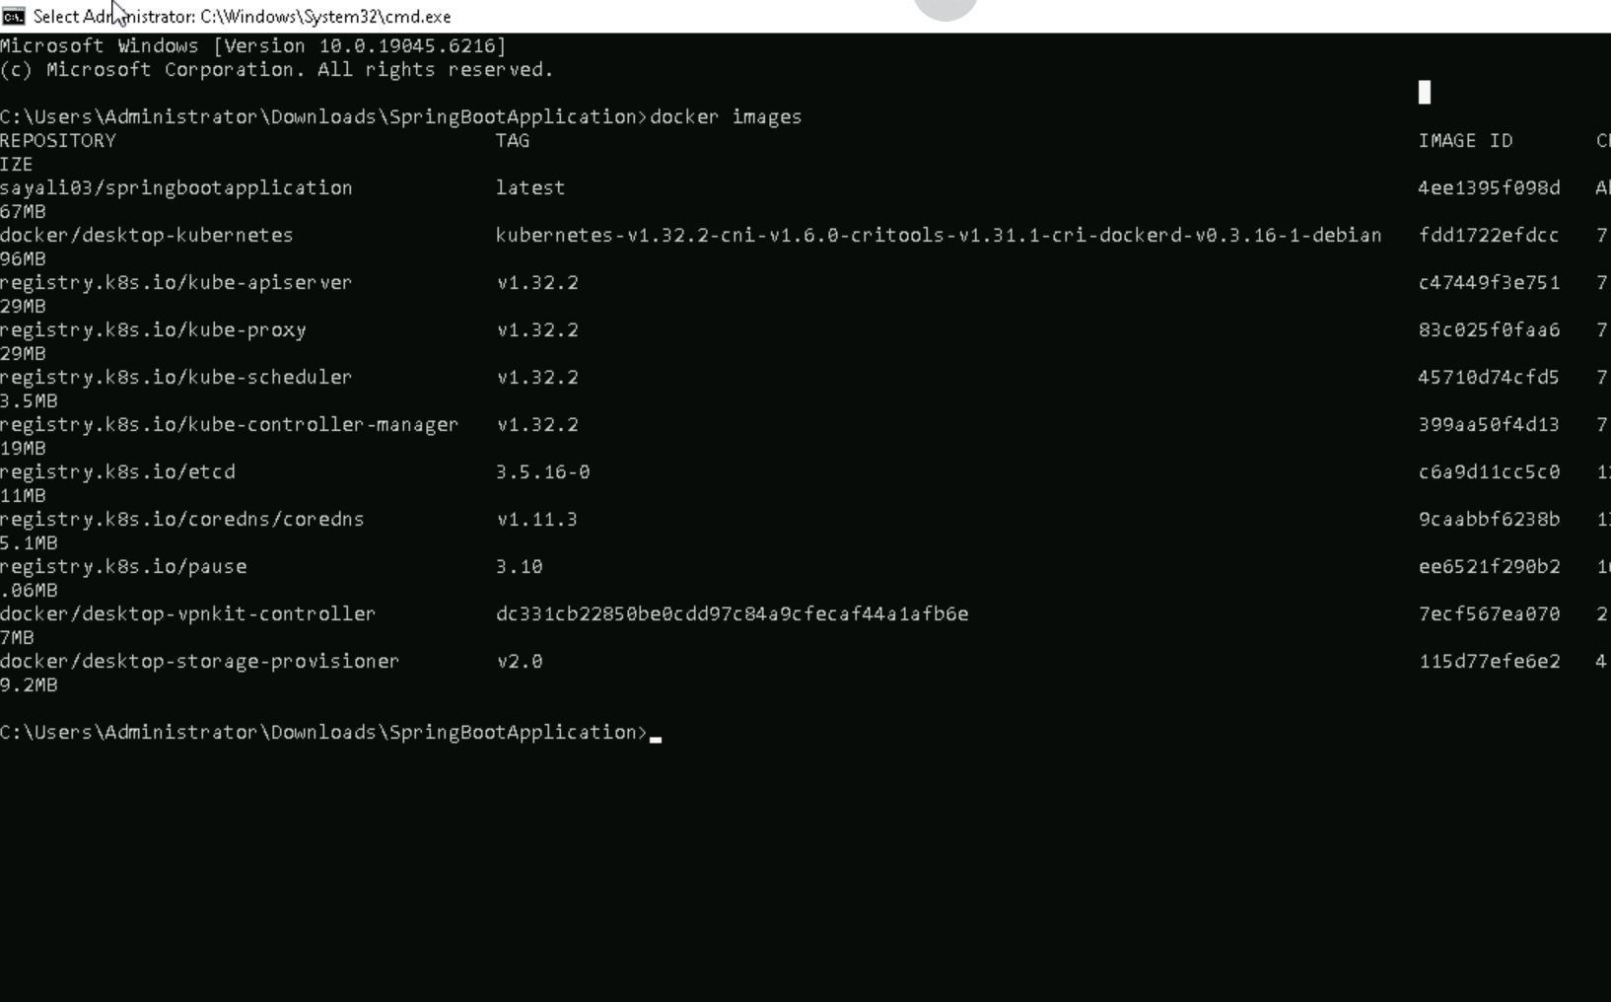
Step 6: List Docker Images
Command: docker images
Displays all locally available Docker images. Confirms your image was built successfully.

Slide 20
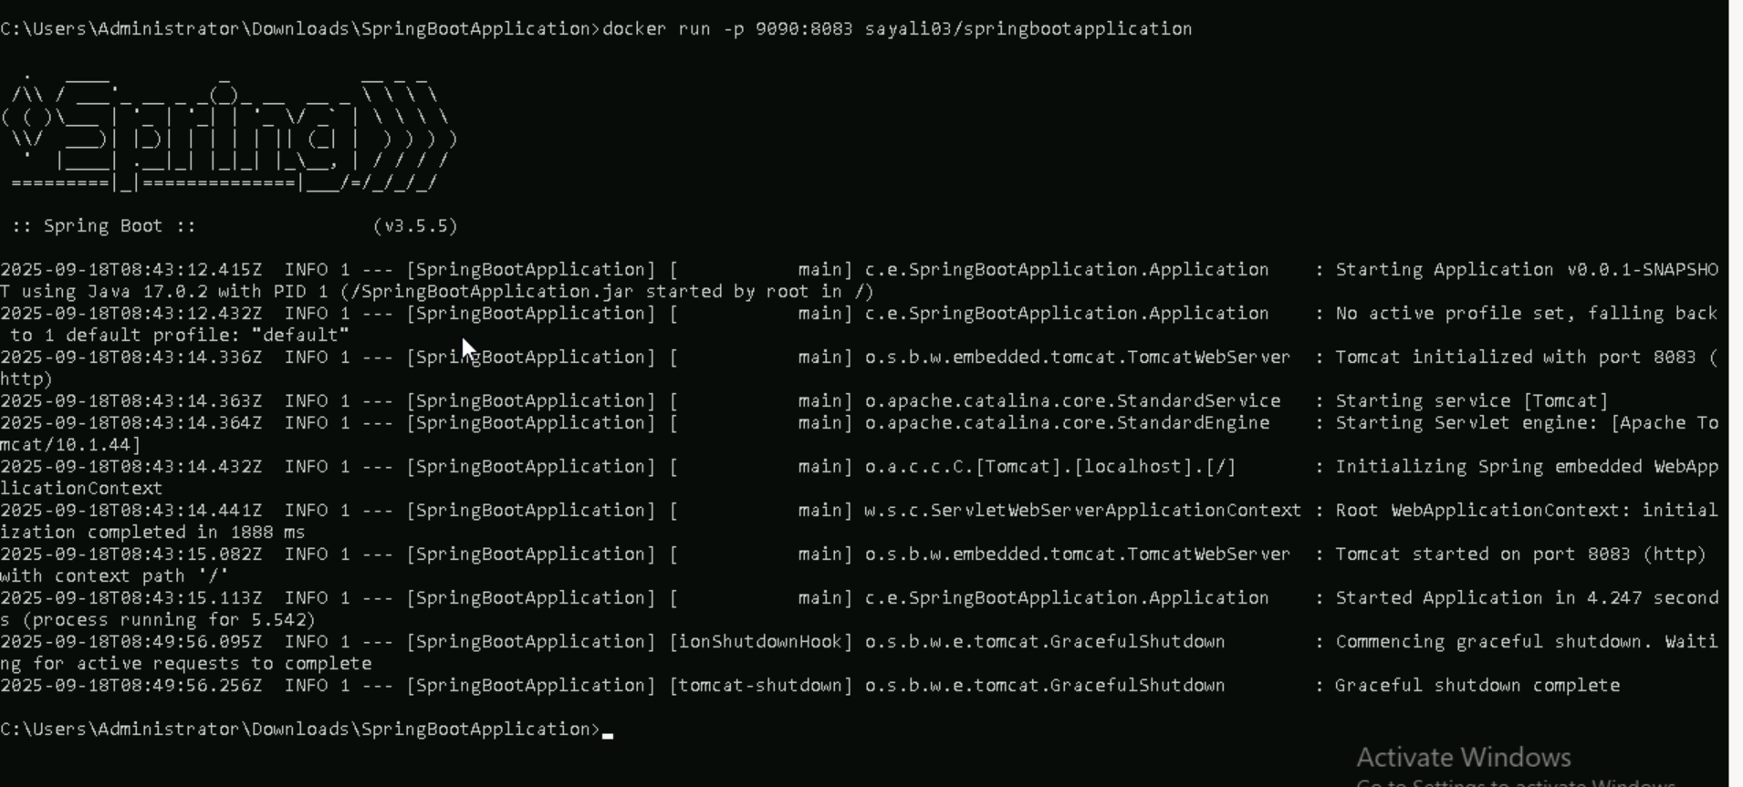
Step 7: Run the Docker Container
Command: docker run -p 9090:8083 sayali03/springbootapplication
Starts a container from your image. Maps port 8083 inside the container to 9090 on your machine.

Slide 21
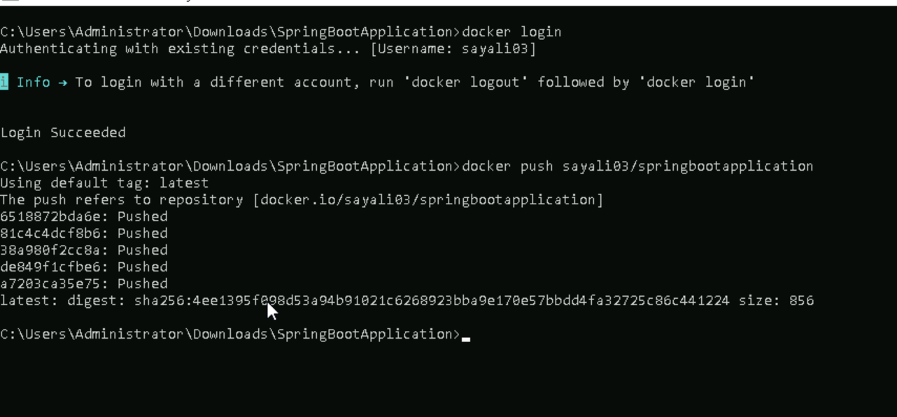
Step 8: Login to DockerHub
Command: docker login
Authenticates your Docker CLI with DockerHub so you can push images.
Step 9: Push the Image to DockerHub
Command: docker push sayali03/springbootapplication
Uploads your image to DockerHub so others can pull and use it.

Slide 22
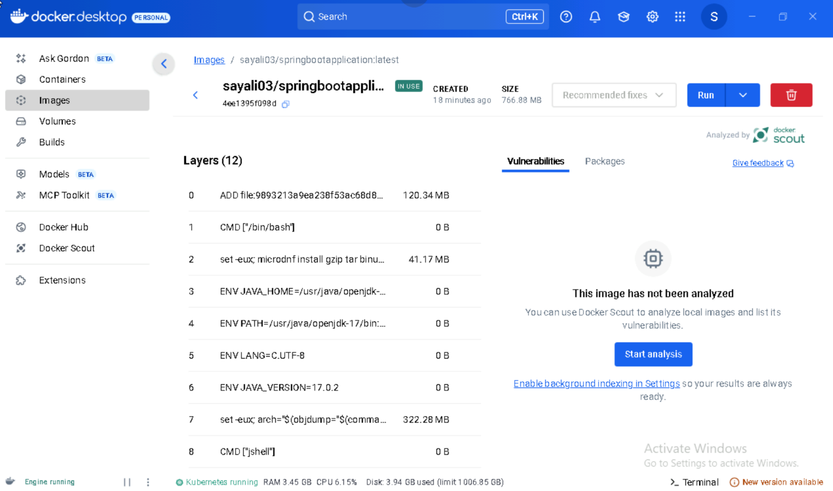
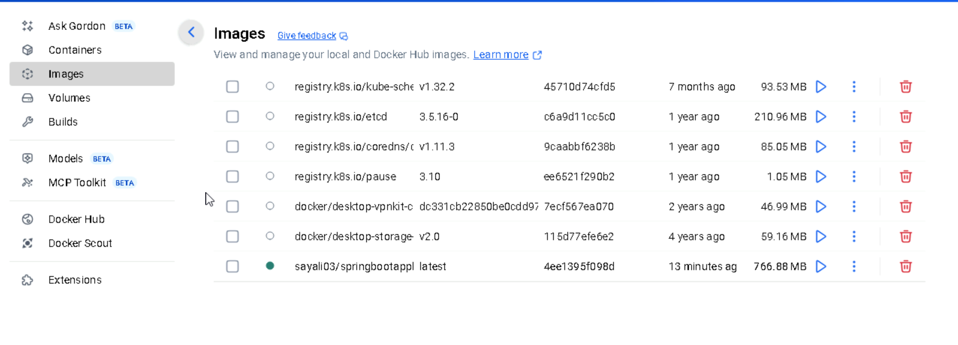
Step 10: Verify Image in Docker Desktop
Open Docker Desktop → Go to "Images" tab.
Confirms your image is available locally and/or synced with DockerHub.

